Slide 1
Dance, Dance, Revolution

Slide 2
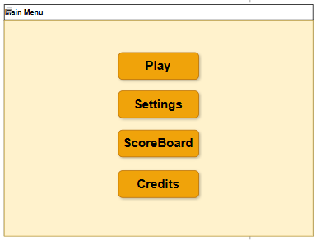
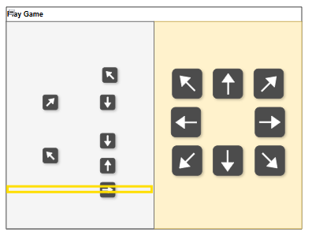
The Idea

Slide 3
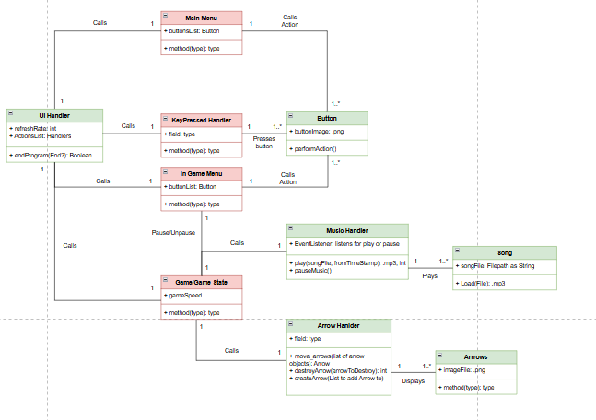


Slide 4


Slide 5
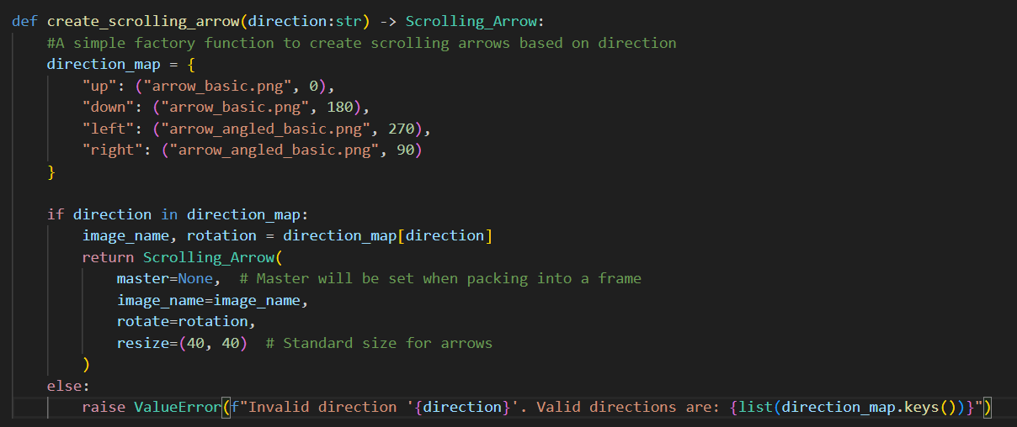
Factory Design Pattern
Notes:
I am going to use a list of arrows in the Game_frame class.
Keep things readable and simple. I also needed a simple way to randomly select which direction the arrows are going to face.

Slide 6

Observer Design Pattern

Slide 7
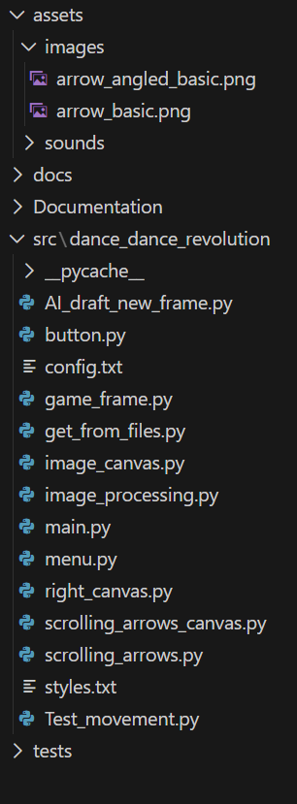
Notes:
My file org is a mess

Slide 8
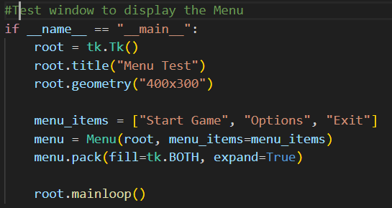
Testing each class

Slide 9
Challenges
Frames Vs. Canvas Vs. Canvas_Images
Planning Reliability
Reusability is over 9000!
Did not pre plan tests

